Slide 1
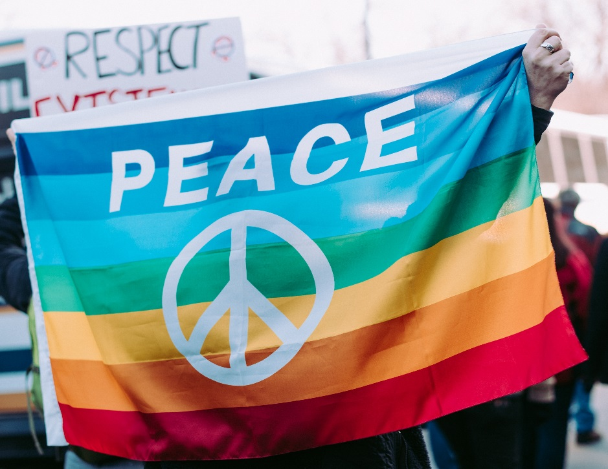
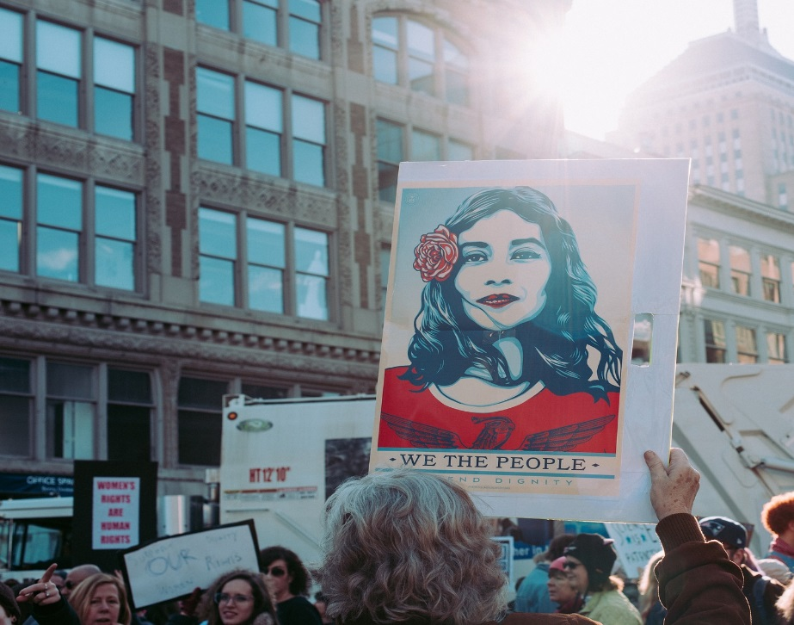
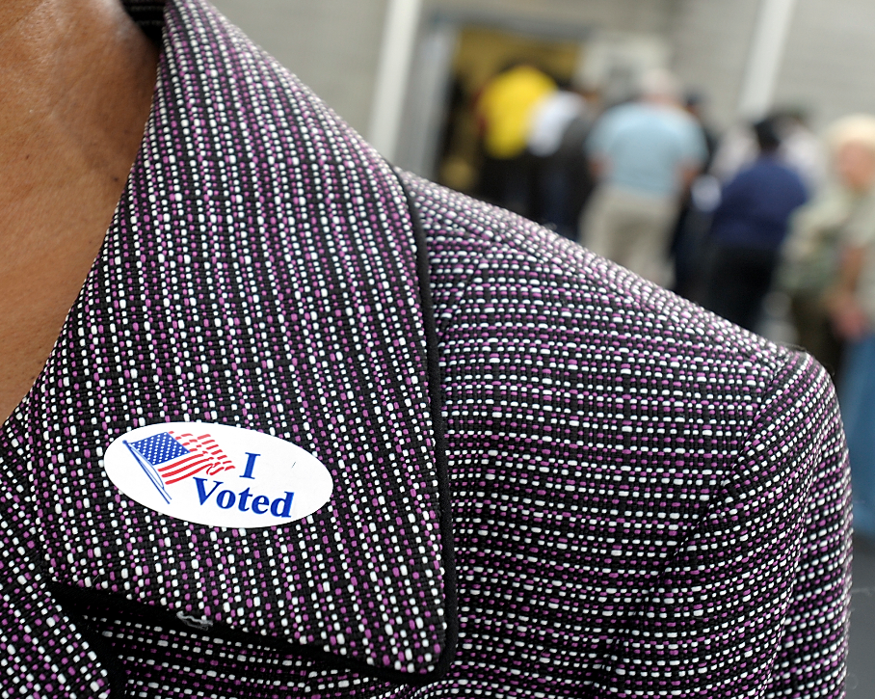
Women on the rise: stories from a movement
Chester county fund for women and girls

Slide 2
Tweet along with us!
#PAWomenRising
Tag us: @ccwomenandgirls

Slide 3
Review of some key 2017 events
January - March | April - June | July - September | October - December
Donald J. Trump Sr. inaugurated as the 45th U.S. president Some million women and supporters engaged in protest marches across the country and world Debate explodes about welcoming refugees from certain Muslim-majority nations | Neil Gorsuch confirmed on the US Supreme Court, a significant add Pennsylvania’s unemployment rate drops to 5% from a year that opened at 5.2% US healthcare debate ensues | Statewide focus on opioid abuse intensifies The “Unite the Right” rally in Charlottesville, Virginia, left one woman dead and inflamed race relations nationwide Trump Administration announces end of DACA program | The #metoo movement erupts in response to sexual assault allegations involving prominent men Chester County saw women sweep a swath of political offices Trump Administration wins passage of major tax cut

Slide 4
Where women stand
United States
2017
2018
Governors | 4 women of 50 states | 6 women of 50 states
Senators | 25 women of 100 | 22 women of 100
Representatives | 84 women of 435 | 84 women of 435
Pennsylvania
Senators | 6 women of 50 | 9 women of 50
Representatives | 40 women of 203 | 40 women of 203
Judges
PA Supreme Court | 3 women of 7 | 3 women of 7
PA Superior Court | 2 women of 19 | 5 women of 19
Chester County
County commissioners | 2 women of 3 | 2 women of 3
Row offices | 1 woman of 4 | 4 women of 4

Slide 5
2018 Midterm election cycle
United States
Senate – 33 seats of 100 up
House of Representatives – all 435 seats up
Pennsylvania
Governor
Lieutenant Governor
State Senate
State House of Representatives
Primary Day – May 15 General Election Day – Nov. 6

Slide 6
Did you know?
Since 1953, there has never been more than two women (regardless of party) in the Pennsylvania Congressional delegation at once.
Since 2015, there have been no women in the Pennsylvania Congressional delegation.

Slide 7
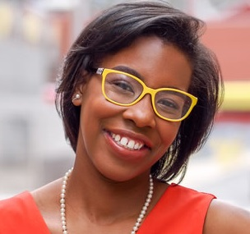
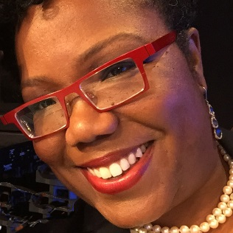
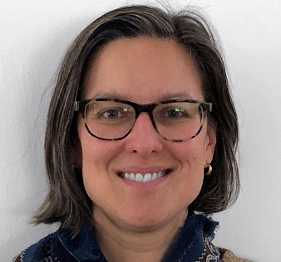
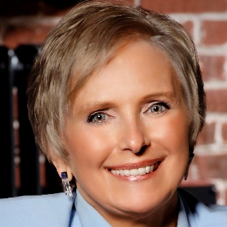
Keep the conversation going!
CCFWG
Facebook/ccwomenandgirls
Twitter/@ccwomenandgirls
Nia Ngina Meeks
Facebook/Nia Means Purpose
Twitter/@nmpurpose
Patricia Maisano
Facebook/pamaisano
Twitter/@pamaisano ‏
Jasmine E. Sessoms
Facebook/SheCanWinNow
Twitter/@SheCanWinNow
Kate Young
Facebook/kate.young.712
#PAWomenRising
Tag us: @ccwomenandgirls

